Slide 1

Home Sales Analysis, Pre-COVID & COVID Era
By: Corban Doran, Ashley Morgan, & Will Wright
May 2, 2022
Photo credit: Glasshouse Images / Getty Images

Slide 2
Success Factors:
Final Sale Price as a Percentage of Asking Price
Time Home was Listed Before Sale
Home Attributes Analyzed:
Size
School Ratings
Property Subtype

Slide 3
Data Cleaning
Dropped extraneous columns, not related to analysis
Calculated success factors
Renamed repeat school names
Dropped null values
Trimmed set by around 3,000 sales:
Entries most likely typos (data off by an order of magnitude, missing integers, extra integers)
Notes:
- GreatSchools
-Weren't able to capture historic school ratings

Slide 4
House Size in Square Ft.
Notes:
- GreatSchools
-Weren't able to capture historic school ratings

Slide 5
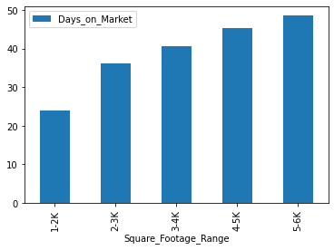
Days On Market vs Sq. Ft.

Slide 6
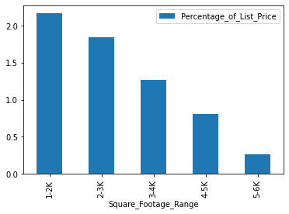
Percentage of List Price (-97%) vs Sq. Ft.

Slide 7
School Ratings
Notes:
- GreatSchools
-Weren't able to capture historic school ratings

Slide 8
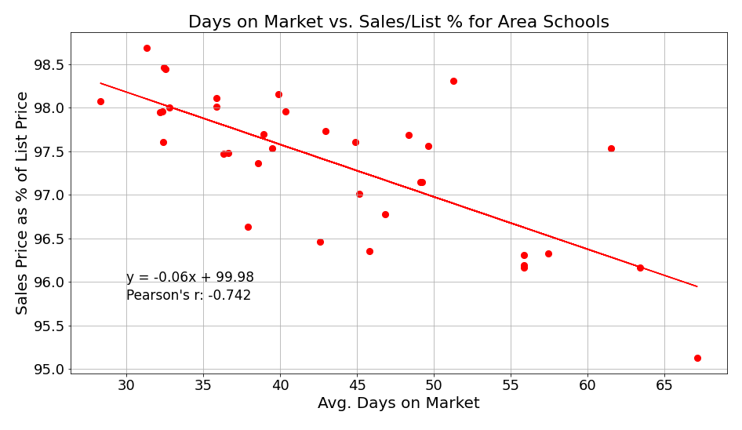

Slide 9
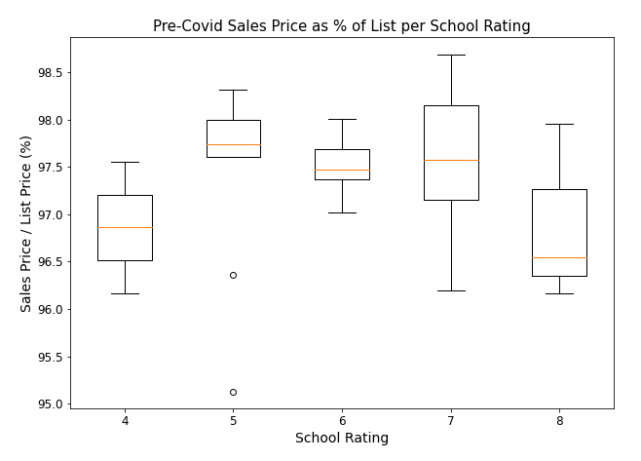
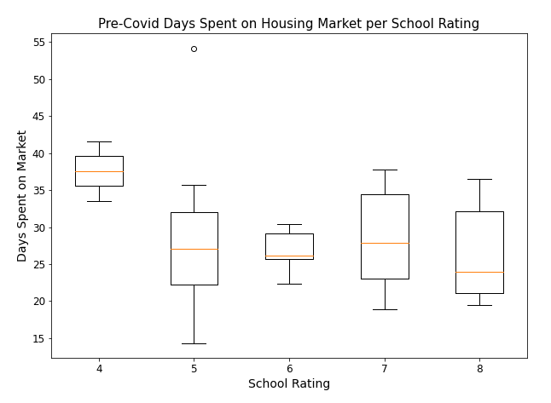

Slide 10
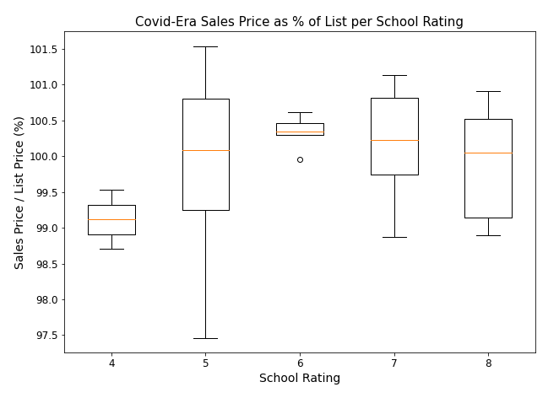


Slide 11
Property Subtypes

Slide 12
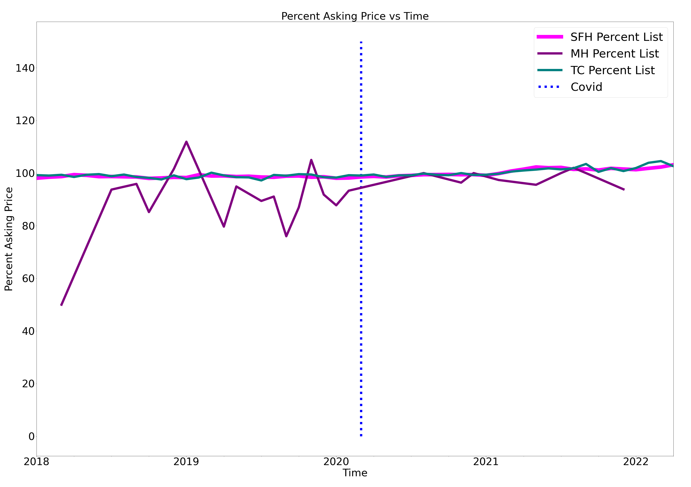

Slide 13
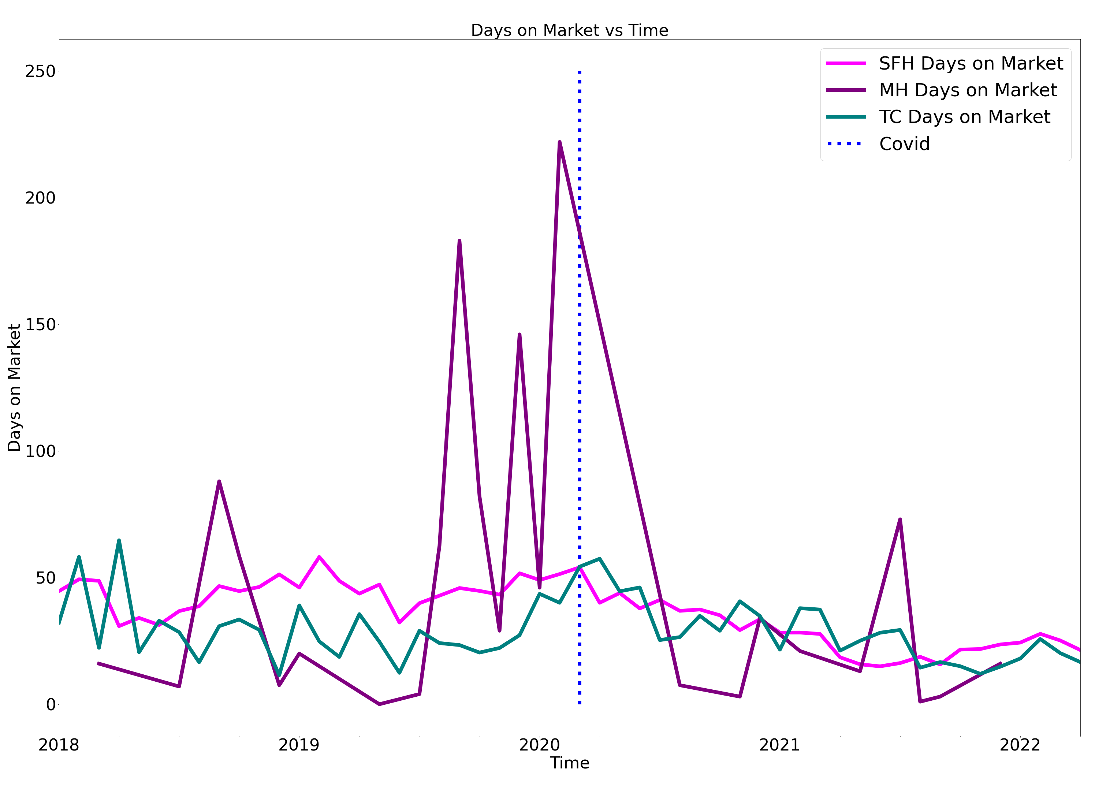

Slide 14
Conclusions
Home size had correlation with factors at the inverse of the hypothesis. This could be due to differences in demand which could be investigated further
Higher-rated schools did not appear to have a measurable effect the sales price of a home, while homes in higher-rated school districts did tend to sell more quickly
COVID-19 did not appear to have much effect on school ratings as it relates to our success factors
Overall mobile homes had the most success when looking at the change in percent of sells price and days on the market over time especially after the onset Covid-19 pandemic.

